Slide 1

Noida Institute of Engineering and Technology, Greater Noida (An Autonomous Institute) School of Computer Science & Engineering in Emerging Technologies
Transport Layer
Unit: 4
Computer Networks
ACSE0602
Ms. MANISHA
Assistant Professor
CS
B Tech 6th Sem
Session 2023-24

Slide 2
Contents
Evaluation Scheme
Syllabus
Branch wise syllabus
Course Objective
Course Outcome
Program Outcome
CO-PO Mapping
PSO
CO- PSO Mapping
PEO
Result analysis
Paper template
Prerequisites
Introduction to subject
Unit objective
TRANSPORT LAYER –
Topic Objective
Quality of Service
Services
Multiplexing

Slide 3
Contents
End –to –end delivery
Addressing
Reliable Delivery
Flow Control
USER DATAGRAM PROTOCOL (UDP)
Transmission Control Protocol (TCP)
Session LAYER
Topic Objective & Recap of previous topic
Functions of Session Layer
Design Issues with Session Layer
Remote Procedure Call (RPC)
Presentation Layer - OSI Model
Topic Objective & Recap of previous topic
Functions of Presentation Layer
Design Issues with Presentation Layer
Data compression techniques
Cryptography

Slide 4
Contents
Video Links
Quiz
Weekly assignment
MCQ
Old Question papers
Expected Questions in University exams
Summary
Reference

Slide 5
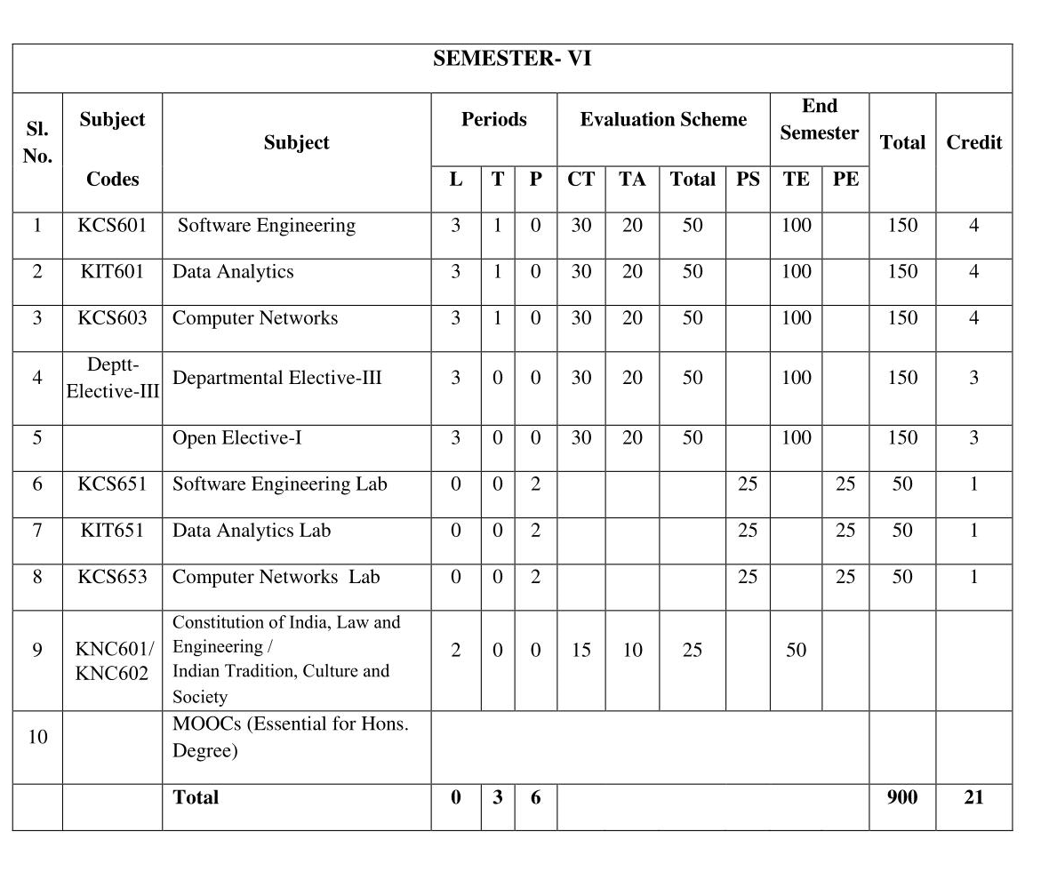
Evaluation Scheme
Ms. Ibtesaam Rais ACSE-0503 CN Unit Number: 4

Slide 6
Syllabus
Unit | Topic
I | Introductory Concepts: Goals and applications of networks, Categories of networks, Organization of the Internet, ISP, Network structure and architecture (layering principles, services, protocols and standards), The OSI reference model, TCP/IP protocol suite, Network devices and components. Physical Layer: Network topology design, Types of connections, Transmission media, Signal transmission and encoding, Network performance and transmission impairments, Switching techniques and multiplexing.
II | Link layer: Framing, Error Detection and Correction, Flow control (Elementary Data Link Protocols, Sliding Window protocols). Medium Access Control and Local Area Networks: Channel allocation, Multiple access protocols, LAN standards, Link layer switches & bridges (learning bridge and spanning tree algorithms).
III | Network Layer: Point-to-point networks, Logical addressing, Basic internetworking (IP, CIDR, ARP, RARP, DHCP, ICMP), Routing, forwarding and delivery, Static and dynamic routing, Routing algorithms and protocols, Congestion control algorithms, IPv6.
IV | Transport Layer: Process-to-process delivery, Transport layer protocols (UDP and TCP), Multiplexing, Connection management, Flow control and retransmission, Window management, TCP Congestion control, Quality of service.
V | Application Layer: Domain Name System, World Wide Web and Hyper Text Transfer Protocol, Electronic mail, File Transfer Protocol, Remote login, Network management, Data compression, Cryptography – basic concepts.

Slide 7
Branch wise Applications
Resource Sharing
Server-Client model:
Communication Medium:
Access to remote information
Person-to-person communication
Electronic commerce
Cloud-based Applications
AI and Expert System
Neural Networks and parallel programming
Decision support and office automation systems etc.
Ms. Ibtesaam Rais ACSE-0503 CN Unit Number: 4

Slide 8

Course Objective
To develop an understanding of
computer networking basics.
different components of computer networks.
study and understand various protocols.
standard models for the layered approach to communication between autonomous machines in a network.
study and understand the main characteristics of data transmission across various physical link types.

Slide 9

Course Outcome
At the end of the course, the student will be able
Course Outcomes (CO) |  | Bloom’s Knowledge Level (KL)
ACSE0503.1 | Explain basic concepts, OSI reference model, services and role of each layer of OSI model and TCP/IP, networks devices and transmission media, Analog and digital data transmission | K1, K2
ACSE0503.2 | Apply channel allocation, framing, error and flow control techniques. | K3
ACSE0503.3 | Describe the functions of Network Layer i.e. Logical addressing, subnetting & Routing Mechanism | K2, K3
ACSE0503.4 | Explain the different Transport Layer function i.e. Port addressing, Connection Management, Error control and Flow control mechanism. | K2, K3
ACSE0503.5 | Explain the functions offered by session and presentation layer and their Implementation. | K2, K3

Slide 10
Program Outcome
1. Engineering knowledge
2. Problem analysis
3. Design/development of solutions
4. Conduct investigations of complex problems
5. Modern tool usage
6. The engineer and society
7. Environment and sustainability
8. Ethics
9. Individual and team work
10. Communication
11. Project management and finance
12. Life-long learning
Ms. Ibtesaam Rais ACSE-0503 CN Unit Number: 4

Slide 11
CO-PO Mapping
The highlighted text shows the mapping of course outcome with PO mapping of this unit
Computer Networks (ACSE-0503) |  |  |  |  |  |  |  |  | Year of Study: 2022-23
CO | PO1 | PO2 | PO3 | PO4 | PO5 | PO6 | PO7 | PO8 | PO9 | PO10 | PO11 | PO12
ACSE0503.1 | 3 | 2 | 3 | 2 | 1 | 1 |  |  |  |  | 2 | 3
ACSE0503.2 | 3 | 3 | 2 | 2 | 3 | 2 |  | 1 |  |  | 1 | 3
ACSE0503.3 | 3 | 2 | 1 |  | 1 | 2 |  | 1 | 2 |  | 1 | 3
ACSE0503.4 | 2 | 2 | 1 |  | 1 |  |  | 1 | 1 |  | 1 | 3
ACSE0503.5 | 2 | 2 | 2 |  | 1 |  |  |  |  |  | 1 | 3

Slide 12
Program Specific Outcomes
PSO1: Apply Artificial Intelligence and its applications to design intelligent systems for the betterment of society.
PSO2: Develop AI-based innovative solutions demonstrating research, entrepreneurship, professional ethics, and communication skills.
PSO3: Demonstrate competency in AI by working in a team and engaging in life-long learning.
Ms. Ibtesaam Rais ACSE-0503 CN Unit Number: 4

Slide 13
CO-PSO Mapping
The highlighted text shows the mapping of course outcome with PSO mapping of this unit
CO | PSO1 | PSO2 | PSO3 | PSO4
ACSE0503.1 | 3 | 3 | 2 | 1
ACSE0503.2 | 3 | 3 | 2 | 1
ACSE0503.3 | 3 | 3 | 2 | 1
ACSE0503.4 | 3 | 3 | 1 | 1
ACSE0503.5 | 3 | 3 | 1 | 1

Slide 14
Program Educational Objectives
PEO1: Engage in successful professional practices in the area of Artificial Intelligence and pursue higher education and research.
PEO2: Demonstrate effective leadership and communicate as an individual and as a team in the workspace and society.
PEO3: Pursue life-long learning in developing AI-based innovative solutions for the betterment of society.
Ms. Ibtesaam Rais ACSE-0503 CN Unit Number: 4

Slide 15
Result Analysis
New Batch in CSE&ET
Ms. Ibtesaam Rais ACSE-0503 CN Unit Number: 4

Slide 16

End Semester Question Paper Template
B TECH
(SEM-V) THEORY EXAMINATION 20__-20__
COMPUTER NETWORK
Time: 3 Hours Total Marks: 100
Note: 1. Attempt all Sections. If require any missing data; then choose suitably.
SECTION A
Attempt all questions in brief. 2 x 10 = 20
Q.No. | Question | Marks | CO
1 |  | 2
2 |  | 2
. |  | .
10 |  | 2
Ms. Ibtesaam Rais ACSE-0503 CN Unit Number: 4

Slide 17
End Semester Question Paper Templates
SECTION B
2. Attempt any three of the following: 3 x 10 = 30
SECTION C
3. Attempt any one part of the following: 1 x 10 = 10
Q.No. | Question | Marks | CO
1 |  | 10
2 |  | 10
. |  | .
5 |  | 10
Q.No. | Question | Marks | CO
1 |  | 10
2 |  | 10
Ms. Ibtesaam Rais ACSE-0503 CN Unit Number: 4

Slide 18
End Semester Question Paper Templates
4. Attempt any one part of the following: 1 x 10 = 10
5. Attempt any one part of the following: 1 x 10 = 10
6. Attempt any one part of the following: 1 x 10 = 10
Q.No. | Question | Marks | CO
1 |  | 10
2 |  | 10
Q.No. | Question | Marks | CO
1 |  | 10
2 |  | 10
Q.No. | Question | Marks | CO
1 |  | 10
2 |  | 10
Ms. Ibtesaam Rais ACSE-0503 CN Unit Number: 4

Slide 19
End Semester Question Paper Templates
7. Attempt any one part of the following: 1 x 10 = 10
Q.No. | Question | Marks | CO
1 |  | 10
2 |  | 10
Ms. Ibtesaam Rais ACSE-0503 CN Unit Number: 4

Slide 20
Prerequisite
The student should have knowledge of
Networking
Layout of computer
Hardware
The basic knowledge of C

Slide 21
Brief Introduction to Subject
Computer network is a group of devices connected with each other through a transmission medium such as wires, cables etc.
These devices can be computers, printers, scanners, Fax machines etc.
The purpose of having computer network is to send and receive data stored in other devices over the network.
Ms. Ibtesaam Rais ACSE-0503 CN Unit Number: 4

Slide 22

Course Objective / Unit Objective
To develop an understanding of
computer networking basics,
to understand different components of computer networks,
various protocols,
the standard models for the layered approach to communication between autonomous machines in a network,
and the main characteristics of data transmission across various physical link types.

Slide 23
TRANSPORT LAYER(CO1)
Topic Objective
The student will be able to understand the basic concept and terms of transport layer
Understand the working of various transport layer protocols

Slide 24
TRANSPORT LAYER(CO1)
The transport layer is the core of the OSI model.
Protocols at this layer oversee the delivery of data from an application program on one device to an application program on another device.
They act as a liaison between the upper-layer protocols (session, presentation, and application) and the services provided by the lower layers.

Slide 25
TRANSPORT LAYER
Duties of the transport layer:
The services provided are similar to those of the data link layer.
provides services across an internetwork made of many networks.
While the transport layer controls all three of the lower layers.

Slide 26
TRANSPORT LAYER
Quality of Service
The transport protocol improves the QoS (Quality of Service) provided by the network layer.
Following are the QoS parameters:
• Connection establishment delay:
the amount of time elapsing between a transport connection being requested and the confirmation being received by the user of the transport service.
Connection establishment failure probability:
the chance of a connection not being established within the maximum establishment delay time.

Slide 27
TRANSPORT LAYER(CO4)
• Throughput:
measures the number of bytes of user data transferred per second, measured over some time interval.
Transit delay:
the time between a message being sent by the transport user on the source machine and its being received by the transport user on the destination machine.
• The Residual error ratio:
the number of lost or garbled messages as a fraction of the total sent.

Slide 28
TRANSPORT LAYER(CO5)
• The Protection
a way for the transport user to specify interest in having the transport layer provide protection against unauthorized third parties (wiretappers) reading or modifying the transmitted data.
• The Priority
a way for a transport user to indicate that some of its connections are more important than other ones, and in the event of congestion, to make sure that the high-priority connections get serviced before the low-priority ones.

Slide 29
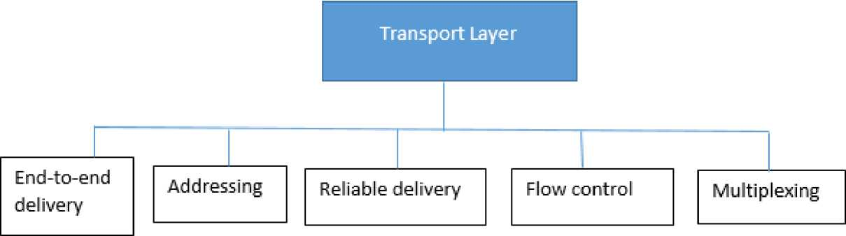
TRANSPORT LAYER(CO1)
The services provided by transport layer protocols can be divided into five broad categories:
end-to-end deliver,
addressing,
reliable delivery,
flow control, and
multiplexing.

Slide 30
TRANSPORT LAYER
End -to -end delivery
The network layer oversees the end-to-end delivery of individual packets but does not see any relationship between those packets, even those belonging to a single message.
It treats each as an independent entity. The transport layer, on the other hand, makes sure that the entire message (not just a single packet) arrives intact. Thus, it oversees the end-to-end (source -to-destination) delivery of an entire message.

Slide 31
TRANSPORT LAYER
Addressing
The transport layer interacts with the functions of the session layer. Communication occurs not just from end machine to end machine but from end application to end application. Data generated by an application on one machine must be received not just by the other machine but by the correct application on that other machine. To ensure accurate delivery from service access point to service access point, we need another level of addressing in addition, the protocol needs to know which upper-layer protocols are communicating.

Slide 32
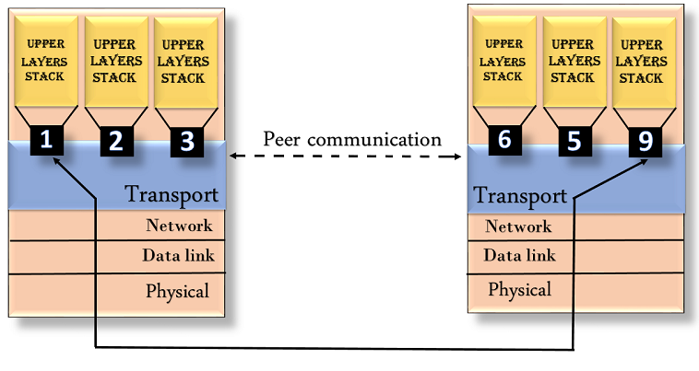
TRANSPORT LAYER
Addressing

Slide 33
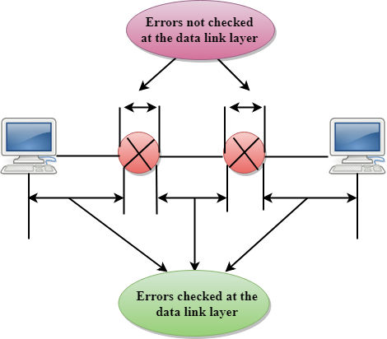
TRANSPORT LAYER
Reliable Delivery
At the transport layer, reliable delivery has four aspects: error control, sequence control, loss control, and duplication control.
Error Control - When transferring data, the primary goal of reliability is error control. Node-to-node reliability of DLL does not ensure end-to-end reliability.

Slide 34
TRANSPORT LAYER
Reliable Delivery
At the transport layer, reliable delivery has four aspects: error control, sequence control, loss control, and duplication control.
Error Control - When transferring data, the primary goal of reliability is error control. Node-to-node reliability of DLL does not ensure end-to-end reliability.
Sequence Control - for ensuring that the various pieces of a transmission are correctly reassembled.
• Segmentation and Concatenation - the transport protocol divides data into smaller, usable blocks. The dividing process is called segmentation. When smaller data then combines them into a single data unit. The combing process is called concatenation.
Sequence Numbers - each segment carries a field that indicates whether it is the final segment of a transmission or a middle segment with more still to come.

Slide 35
TRANSPORT LAYER
• Loss Control - The transport layer ensures that all pieces of a transmission arrive at the destination, not just some of them.
• Duplication Control - guarantee that no pieces of data arrive at the receiving system duplicated.

Slide 36
TRANSPORT LAYER
Flow Control
Flow control is used to prevent the sender from overwhelming the receiver. If the receiver is overloaded with too much data, then the receiver discards the packets and asking for the retransmission of packets. This increases network congestion and thus, reducing the system performance. The transport layer is responsible for flow control.
It uses the sliding window protocol that makes the data transmission more efficient as well as it controls the flow of data so that the receiver does not become overwhelmed. Sliding window protocol is byte oriented rather than frame oriented.

Slide 37
TRANSPORT LAYER
Multiplexing
occurs two ways:
upward, meaning that multiple transport layer connections use the same network connection, or
downward, meaning that one transport-layer connection uses multiple network connections.
The transport layer uses virtual circuits based on the services of the lower three layers. Normally, the underlying networks charge for each virtual circuit connection.
To make more cost effective use of an established circuit, the transport layer can send several transmissions bound for the same destination along the same path by upward multiplexing.

Slide 38
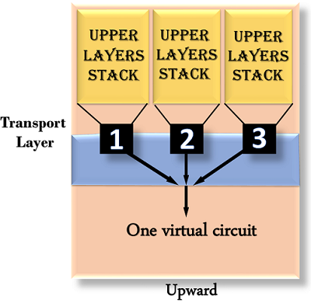
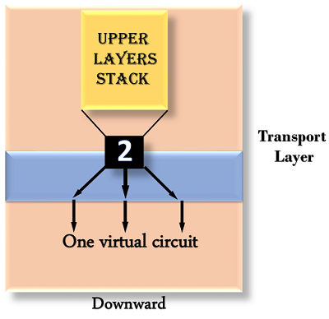
TRANSPORT LAYER
Multiplexing

Slide 39
TRANSPORT LAYER
Multiplexing
Multiplexing is basically a set of techniques that mainly allows the transmission of multiple signals simultaneously across a signals data link.
The multiplexer is used to convert many signals into one so that on the receiving end we can get them simultaneously.

Slide 40
TRANSPORT LAYER
sliding window (windowing)?
The sliding window (windowing) technique is used by Transmission Control Protocol to manage the flow of packets between two computers or network hosts. TCP is a core component of the Internet Protocol suite and operates at the transport layer.
A sliding window protocol controls and optimizes packet flow between a sender and receiver, while ensuring a balanced approach to packet delivery. The protocol requires the receiver to acknowledge receipt of each data packet, and it enables the receiver to use a single acknowledgment (ACK) to confirm the delivery of multiple packets.

Slide 41
TRANSPORT LAYER
ARPANET
ARPA established a packet-switching network of computers linked by point-to-point leased lines called Advanced Research Project Agency Network (ARPANET).
The conventions developed by ARPA to specify how individual computers could communicate across that network became TCP/IP.
The transport layer is represented in TCP/IP by two protocols:
TCP and UDP.

Slide 42
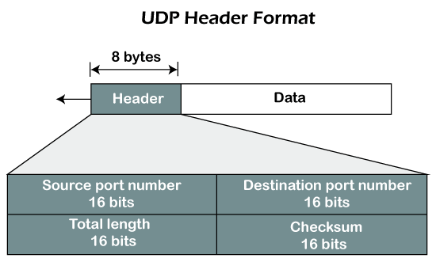
TRANSPORT LAYER(CO3)
USER DATAGRAM PROTOCOL (UDP)

Slide 43
TRANSPORT LAYER(CO3)
USER DATAGRAM PROTOCOL (UDP)
simpler of the two standard TCP/IP transport protocols. It is an end-to-end transport level protocol that adds only port addresses, check sum error control, and length information to the data from the upper layer. The packet produced by the UDP is called a user datagram
• Source port address
The source port address is the address of the application program that has created the message.
• Destination port address
The destination port address is the address of the application program that will receive the message.

Slide 44
TRANSPORT LAYER
• Total length
The total length field defines the total length of the user datagram in bytes.
• Check sum
The check sum is a 16-bit field used in error detection.
UDP provides only the basic functions needed for end-to-end delivery of a transmission.
It does not provide any sequencing or recording functions and cannot specify the damaged packet when reporting an error (for which it must be paired with ICMP). UDP contains only a checksum; it does not contain an ID or sequencing number for a particular data segment

Slide 45
TRANSPORT LAYER(CO3)
Transmission Control Protocol (TCP)
Byte Streaming
Connection Oriented
Full Duplex
Piggy Backing
Error Control
Congestion Control
Flow Control

Slide 46
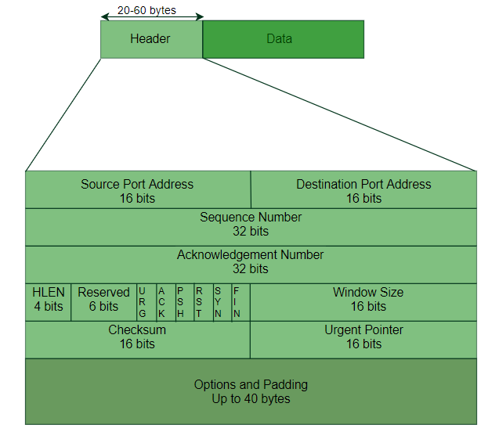
TRANSPORT LAYER(CO3)
Transmission Control Protocol (TCP)

Slide 47
TRANSPORT LAYER(CO3)
Transmission Control Protocol (TCP)
provides full transport layer services to applications. TCP is a reliable stream transport port-to-port protocol, means connection-oriented:
By creating this connection, TCP generates a virtual circuit between sender and receiver that is active for the duration of a transmission TCP begins each transmission by altering the receiver that datagrams are on their way (connection establishment) and ends each transmission with a connection termination.
In this way, the as a connection-oriented service, is responsible for the reliable delivery of the entire stream of bits contained in the message originally generated by the sending application.

Slide 48
TRANSPORT LAYER
Reliability is ensured by provision for error detection and retransmission of damaged frames;
All segments must be received and acknowledged before the transmission is considered complete and the virtual circuit is discarded.

Slide 49
TRANSPORT LAYER
• The TCP Segment
The scope of the services provided by TCP requires that the segment header be extensive.
A brief description of each field is in order.
• Source port address
The source port address defines the application program in the source computer.
• Destination port address
The destination port address defines the application program in the destination computer.

Slide 50
TRANSPORT LAYER
• Sequence number
A stream of data from the application program may be divided into two or more TCP segments. The sequence number field shows the position of the data in the original data stream.
• Acknowledgement number
The 32-bit acknowledgement number is used to acknowledge the receipt of data from the other communicating device. This number is valid only if the ACK bit in the control field is set.

Slide 51
TRANSPORT LAYER
• Header Length (HLEN)
The four-bit HLEN field indicates the number of 32-bit (four-byte) words in the TCP header. The four bits can define a number up to 15.This is multiplied by 4 to give the total number of bytes in the header. Therefore, the size of the header can be a maximum of 60 bytes (4x15).Since the minimum required size of the header is 20 bytes, 40 bytes are thus available for the options section.
• Reserved
A six-bit field is reserved for future use.

Slide 52
TRANSPORT LAYER
• Control
Each bit of the six-bit control field functions individually and independently. A bit can either define the use of a segment or serve as a validity check for other fields. The urgent bit, when set, validates the urgent pointer field. Both this bit and the pointer indicate that the data in the segment are urgent.
The ACK bit, when set, validates the acknowledgement number field. Both are used together and have different functions, depending on the segment type.
The PSH bit is used to inform the sender that a higher throughput is needed. If possible, data must be pushed through paths with higher throughput. The reset bit is used to reset the connection when there is confusion in the sequence numbers.

Slide 53
TRANSPORT LAYER
The SYN bit is used for sequence number synchronization in three types of segments: connection request, connection confirmation (with the ACK bit set), and confirmation acknowledgement (with the ACK bit set).
The FIN bit is used in connection termination in three types of segments: termination request, termination confirmation (with the ACK bit set), and acknowledgement of termination confirmation (with the ACK bit set).
• Window size
The window is a 16-bit field that defines the size of the sliding window.

Slide 54
TRANSPORT LAYER
• Checksum
The checksum is a 16-bit field used in error detection.
• Urgent pointer
This is the last required field in the header. Its value is valid only if the URG bit in the control field is set. In this case, the sender is informing the receiver that there are urgent data in the data portion of the segment. This pointer defines the end of urgent data and the start of normal data.
• Options and padding
The remainder of the TCP header defines the optional fields. They are used to convey additional information to the receiver or for alignment purposes.

Slide 55
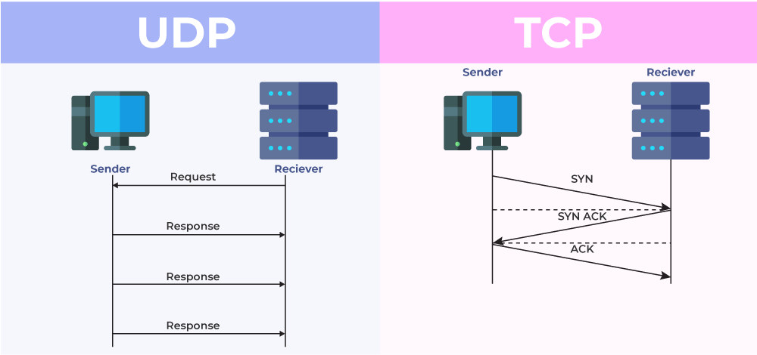
TRANSPORT LAYER

Slide 56
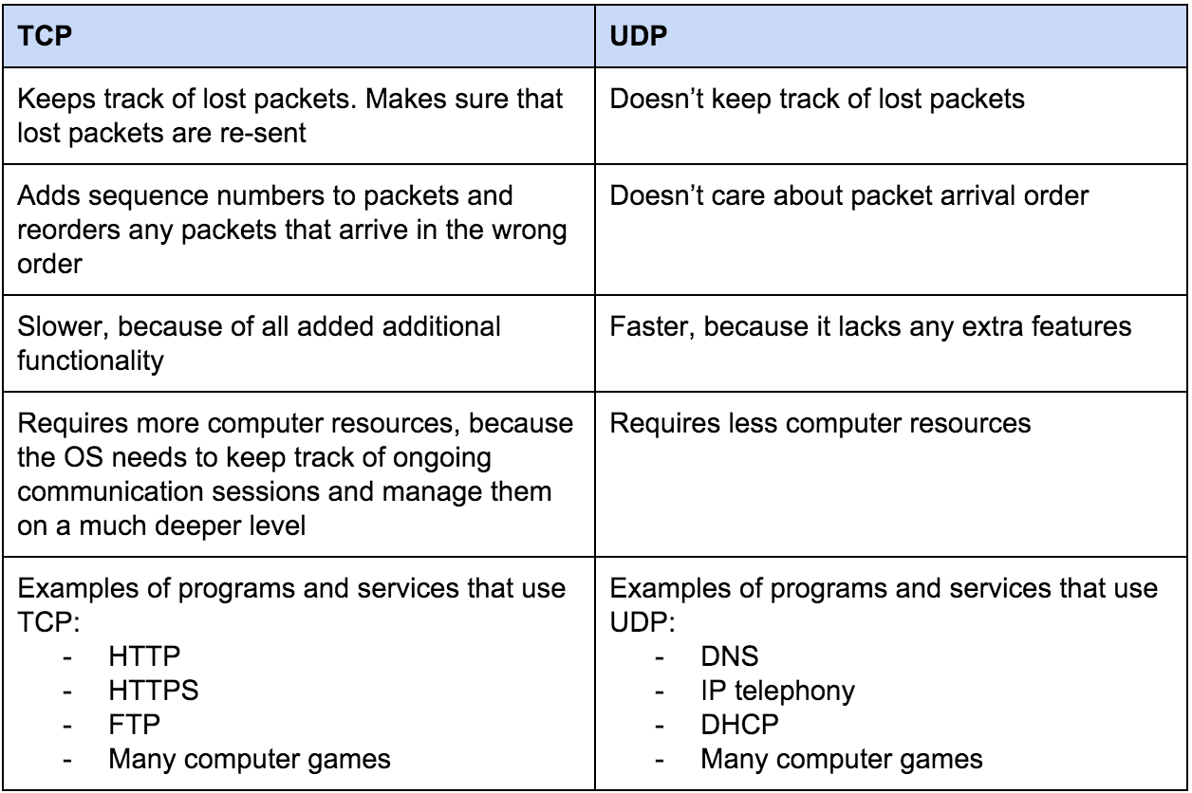
TRANSPORT LAYER

Slide 57
TRANSPORT LAYER
TCP protocol operations may be divided into three phases.
Connections must be properly established in a multi-step handshake process (connection establishment) before entering the data transfer phase. After data transmission is completed, the connection termination closes established virtual circuits and releases all allocated resources.
A TCP connection is managed by an operating system through a programming interface that represents the local end-point for communications, the Internet socket.
• TCP connection states
During the lifetime of a TCP connection the local end-point undergoes a series of state changes:

Slide 58
TRANSPORT LAYER
o LISTEN
(server) represents waiting for a connection request from any remote TCP and port.
o SYN-SENT
(client) represents waiting for a matching connection request after having sent a connection request.
o SYN-RECEIVED
(server) represents waiting for a confirming connection request acknowledgment after having both received and sent a connection request.
o ESTABLISHED
(both server and client) represents an open connection, data received can be delivered to the user. The normal state for the data transfer phase of the connection.

Slide 59
TRANSPORT LAYER
o FIN-WAIT-1
(both server and client) represents waiting for a connection termination request from the remote TCP, or an acknowledgment of the connection termination request previously sent.
o FIN-WAIT-2
(both server and client) represents waiting for a connection termination request from the remote TCP.
o CLOSE-WAIT
(both server and client) represents waiting for a connection termination request from the local user.
o CLOSING
(both server and client) represents waiting for a connection termination request acknowledgment from the remote TCP.

Slide 60
TRANSPORT LAYER
o LAST-ACK
(both server and client) represents waiting for an acknowledgment of the connection termination request previously sent to the remote TCP (which includes an acknowledgment of its connection termination request).
o TIME-WAIT
(either server or client) represents waiting for enough time to pass to be sure the remote TCP received the acknowledgment of its connection termination request.
o CLOSED
(both server and client) represents no connection state at all.

Slide 61
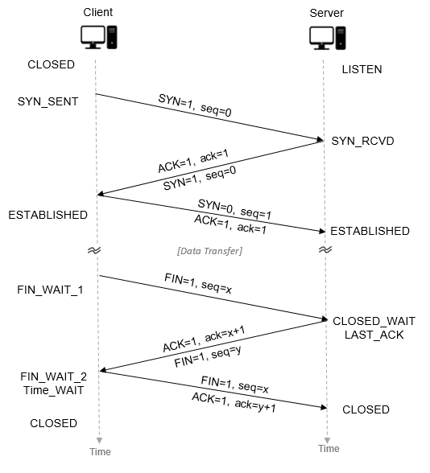
TRANSPORT LAYER
• State Transition of TCP

Slide 62
TRANSPORT LAYER
• Connection establishment
To establish a connection, TCP uses a three-way handshake. Before a client attempts to connect with a server, the server must first bind to and listen at a port to open it up for connections: this is called a passive open. Once the passive open is established, a client may initiate an active open. To establish a connection, the threeway (or 3-step) handshake occurs:
1.SYN: The active open is performed by the client sending a SYN to the server. The client sets the segment's sequence number to a random value A.
2.SYN-ACK: In response, the server replies with a SYN-ACK. The acknowledgment number is set to one more than the received sequence number i.e. A+1, and the sequence number that the server chooses for the packet is another random number, B.

Slide 63
TRANSPORT LAYER
3.ACK: Finally, the client sends an ACK back to the server. The sequence number is set to the received acknowledgement value i.e. A+1, and the acknowledgement number is set to one more than the received sequence number i.e. B+1.
At this point, both the client and server have received an acknowledgment of the connection. The steps 1, 2 establish the connection parameter (sequence number) for one direction and it is acknowledged. The steps 2, 3 establish the connection parameter (sequence number) for the other direction and it is acknowledged. With these, a full-duplex communication is established.

Slide 64
TRANSPORT LAYER
• Connection termination
The connection termination phase uses a four-way handshake, with each side of the connection terminating independently. When an endpoint wishes to stop its half of the connection, it transmits a FIN packet, which the other end acknowledges with an ACK. Therefore, a typical tear-down requires a pair of FIN and ACK segments from each TCP endpoint. After the side that sent the first FIN has responded with the final ACK, it waits for a timeout before finally closing the connection, during which time the local port is unavailable for new connections; this prevents confusion due to delayed packets being delivered during subsequent connections.

Slide 65
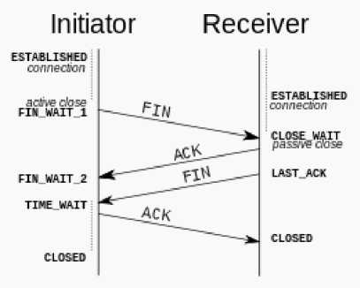
TRANSPORT LAYER

Slide 66
TRANSPORT LAYER
TCP CONGESTION CONTROL
TCP congestion control is a method used by the TCP protocol to manage data flow over a network and prevent congestion.
TCP uses a congestion window and congestion policy that avoids congestion.
Congestion Policy in TCP
Slow Start Phase: Starts slow increment is exponential to the threshold.
Congestion Avoidance Phase: After reaching the threshold increment is by 1.
Congestion Detection Phase: Congestion avoidance phase. The sender goes back to the Slow start phase or the

Slide 67
TRANSPORT LAYER
Slow Start Phase
Exponential increment: In this phase after every RTT the congestion window size increments exponentially.
Example:- If the initial congestion window size is 1 segment, and the first segment is successfully acknowledged, the congestion window size becomes 2 segments. If the next transmission is also acknowledged, the congestion window size doubles to 4 segments. This exponential growth continues as long as all segments are successfully acknowledged
Congestion Avoidance Phase
Additive increment: This phase starts after the threshold value also denoted as ssthresh. The size of cwnd(congestion window) increases additive. After each RTT cwnd = cwnd + 1.

Slide 68
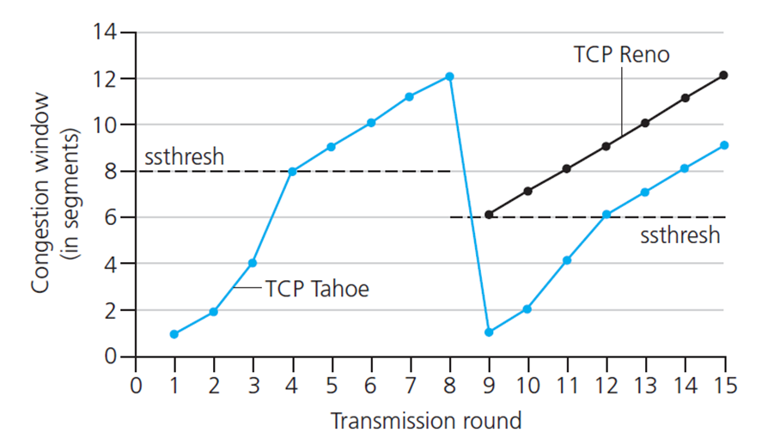
TRANSPORT LAYER
Congestion Detection Phase
Multiplicative decrement: If congestion occurs, the congestion window size is decreased. The only way a sender can guess that congestion has happened is the need to retransmit a segment. Retransmission is needed to recover a missing packet that is assumed to have been dropped by a router due to congestion. Retransmission can occur in one of two cases: when the RTO timer times out or when three duplicate ACKs are received.

Slide 69
TRANSPORT LAYER
Case 1: Retransmission due to Timeout – In this case, the congestion possibility is high.
ssthresh is reduced to half of the current window size.
set cwnd = 1
start with the slow start phase again.
Case 2: Retransmission due to 3 Acknowledgement Duplicates – The congestion possibility is less.
ssthresh value reduces to half of the current window size.
set cwnd= ssthresh
(c)start with congestion avoidance phase

Slide 70

TRANSPORT LAYER

Slide 71
TRANSPORT LAYER
Quality of service
Quality-of-Service (QoS) refers to traffic control mechanisms that seek to either differentiate performance based on application or network-operator requirements or provide predictable or guaranteed performance to applications, sessions, or traffic aggregates. Basic phenomenon for QoS means in terms of packet delay and losses of various kinds.
Need for QoS –
Video and audio conferencing require bounded delay and loss rate.
Video and audio streaming requires bounded packet loss rate, it may not be so sensitive to delay.
Time-critical applications (real-time control) in which bounded delay is considered to be an important factor.
Valuable applications should be provided better services than less valuable app/lications.

Slide 72
MCQ
UDP is a connectionless protocol as It sends data as a stream of related packets All UDP packets are treated independently by Transport layer It is received in the same order as sent order It sends data very quickly
2. A _____ is a TCP name for a transport service access point Pipe Port Node protocol

Slide 73
MCQ
3. The data in the transport layer is in the form of Frames Datagrams Packets All of the above
4. Transport layer protocols work as a Application to application communication Process to process communication Node to node communication Man to man communication

Slide 74
MCQ
5. The ________layer is responsible for source to destination delivery of the entire message Transport Network Data link Physical
6. The header added by the transport layer to the packet coming from the upper layer includes the ____ address Logical Physical Service-point Network

Slide 75
MCQ
7. The division of message into packets is the function of the _____ layer Application Transport Network Data link
8. _____ provides a connection-oriented reliable service for sending messages TCP IP UDP All of the above

Slide 76
MCQ
___________ are used for unicast communication such as cellular telephones, satellite networks
One long cable acts as a backbone to link all the devices in a _____Topology
A computer network is an interconnection of two or more computers that are able to _____ _______
_______ _______ is a physical path by which message transmits
_______a set of rules that govern data communications
the number of physical links in a fully connected mesh network with n nodes = ______
The devices are connected through a _____ in star topology
LANs are distinguished from other types of networks by their ______ and _________

Slide 77
Old Question papers
18-19
https://drive.google.com/open?id=17OUMNnX0kFDc9UB8tx8qd8zyEj7lCD5P
17-18
https://drive.google.com/open?id=1oFmw__qC7wdUP85gUkKbkohZvd9Vopm_
16-17
https://drive.google.com/open?id=1eDrOkj2wVsxdTZPb7-A78YuYn16HC1ob
15-16
https://drive.google.com/open?id=1ljNxmZP1_pl10rbxJvK6xB1ybG7AMuqU
14-15
https://drive.google.com/open?id=1tjERKPwEA9icWcQTBZQnKUq_ttqBDeo5

Slide 78
Expected Question in University exams
Explain the three way handshaking protocol to establish the transport level connection
Explain the TCP header and the working of TCP protocol.
Differentiate TCP and UDP with frame format
Define cryptography with the help of block diagram of Asymmetric and Symmetric Cryptography
Differentiate between block cipher and transpose cipher.

Slide 79
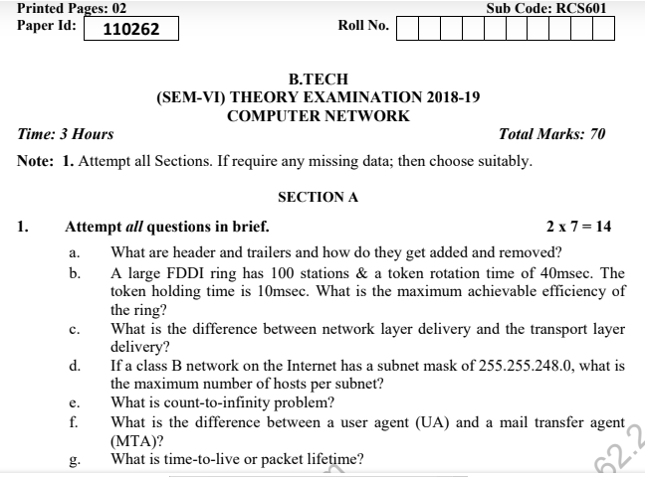
Question paper of University Exam

Slide 80
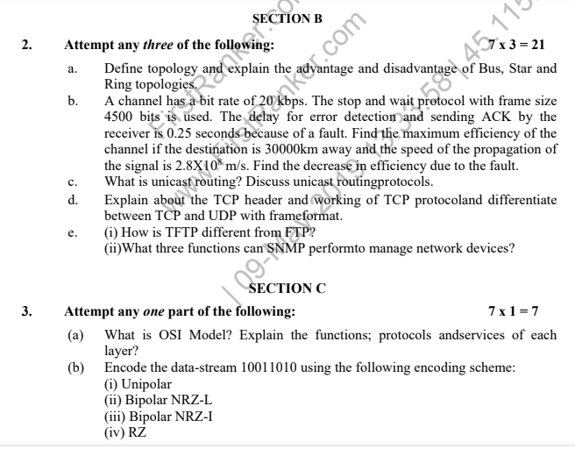
Question paper of University Exam

Slide 81
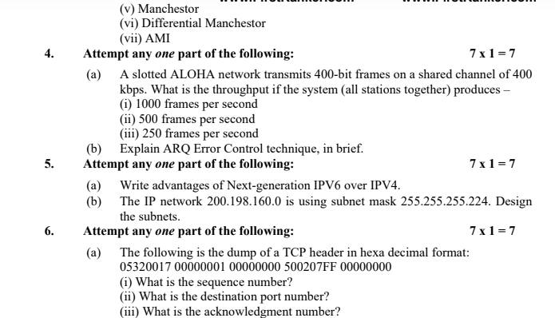
Question paper of University Exam

Slide 82
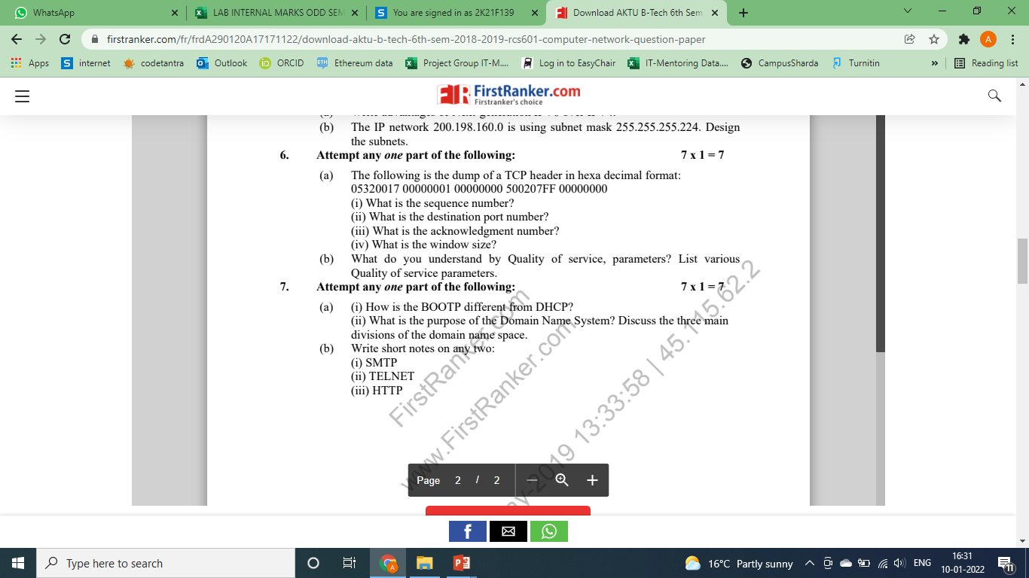
Question paper of University Exam

Slide 83
Summary
Transport Layer and the Design issues covered,
Functions of Transport layer were done in detail
How TCP does connection management elaborated
Session Layer - Design issues,
Overview of remote procedure call.
Presentation Layer-Design issues,
Various Data compression techniques including Lossless and Lossy
Cryptography were discussed

Slide 84
Text Books
Behrouz Forouzan, “Data Communication and Networking”, McGraw Hill
2. Andrew Tanenbaum “Computer Networks”, Prentice Hall.
3. William Stallings, “Data and Computer Communication”, Pearson.
Ms. Ibtesaam Rais ACSE-0503 CN Unit Number: 4

Slide 85
References
1. Forouzen, "Data Communication and Networking", TMH
2. A.S. Tanenbaum, Computer Networks, Pearson Education
3. W. Stallings, Data and Computer Communication, Macmillan Press
4. Gary R.Wright,W.Richard Stevens "TCP/IP Illustrated,Volume2 The Implementation" Addison-Wesley
5. Michael A. Gallo and William M. Hancock "Computer communucation and Networking Technology" Cengage Learning
6. Bhavneet Sidhu, An Integrated approach to Computer Networks, Khanna Publishing House
7. Anuranjan Misra, “Computer Networks”, Acme Learning
8. G. Shanmugarathinam, ”Essential of TCP/ IP”, Firewall Media

Slide 86
Noida Institute of Engineering and Technology, Greater Noida
Thank You

